Slide 1
COMP-4441 Final Project
Navan Powers & Andrew Graham

Slide 2
Research Question
Did the “Stay-at-Home” lockdown orders due to the Covid-19 outbreak affect marijuana dispensary sales in Colorado?

Slide 3
Data Sources
Marijuana Sales Data
Colorado Department of Revenue
https://cdor.colorado.gov/data-and-reports/marijuana-data/marijuana-sales-reports
January 2014 – May 2021
Covid Incidence Data
Colorado Department of Public Health & Environment
https://covid19.colorado.gov/data
March 2020 – Present
Note: Marijuana dispensaries were classified as part of state’s Health Care Sector and allowed to remain open during lockdown orders

Slide 4
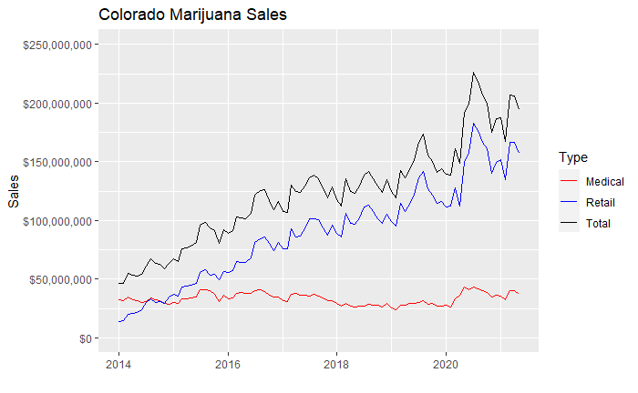
Initial Data Plot

Slide 5
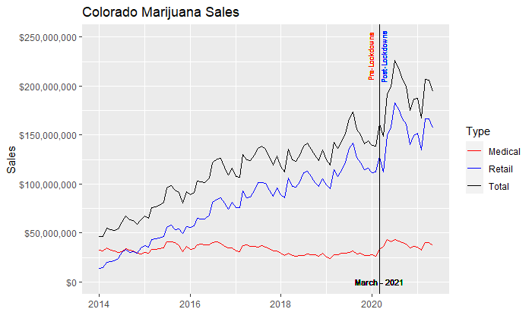
Initial Data Plot – Lockdown Marker

Slide 6
Chow Test –
Structural break in data between two or more regressions
Used to determine if there is a structural break in data linearity between two or more regressions in split data sets
Test if single line or two separate regression lines best fit the data
Often times used to analyze two different data sets to see if they can be pooled together
Regression discontinuity
Commonly used in econometrics
Regression stability test
Returns p-value of regression stability

Slide 7
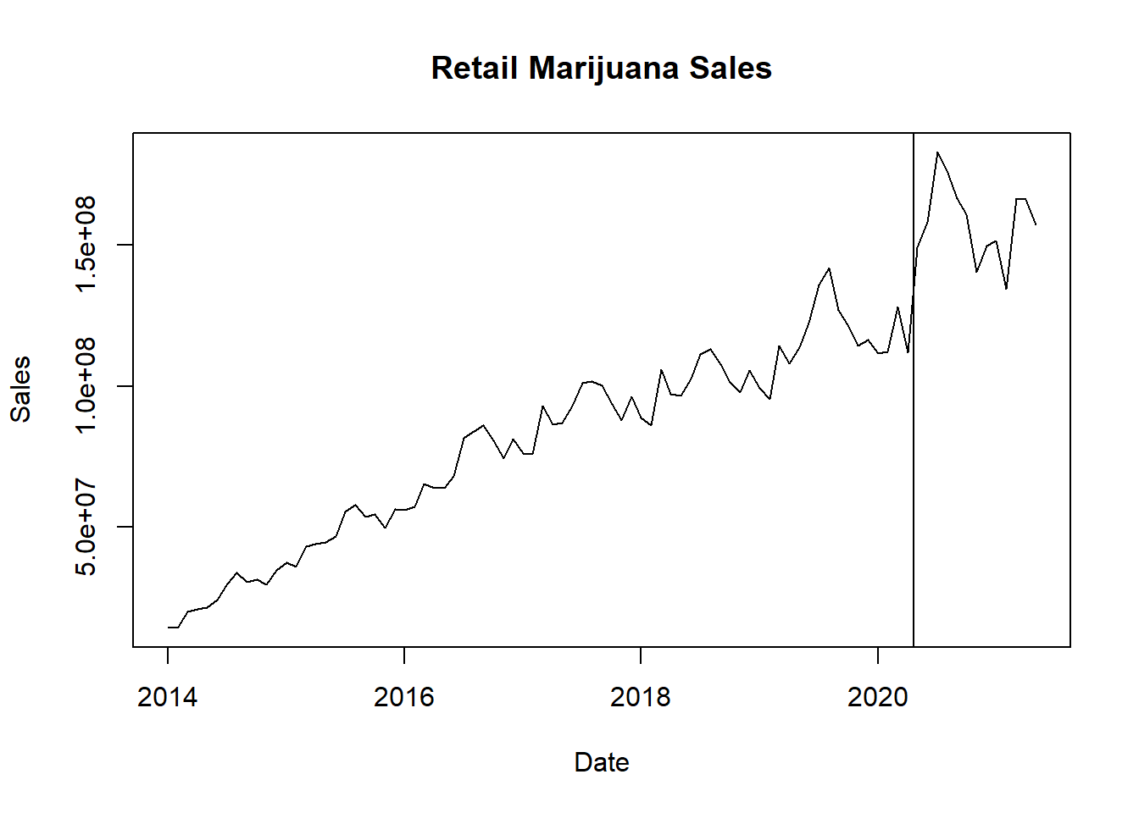
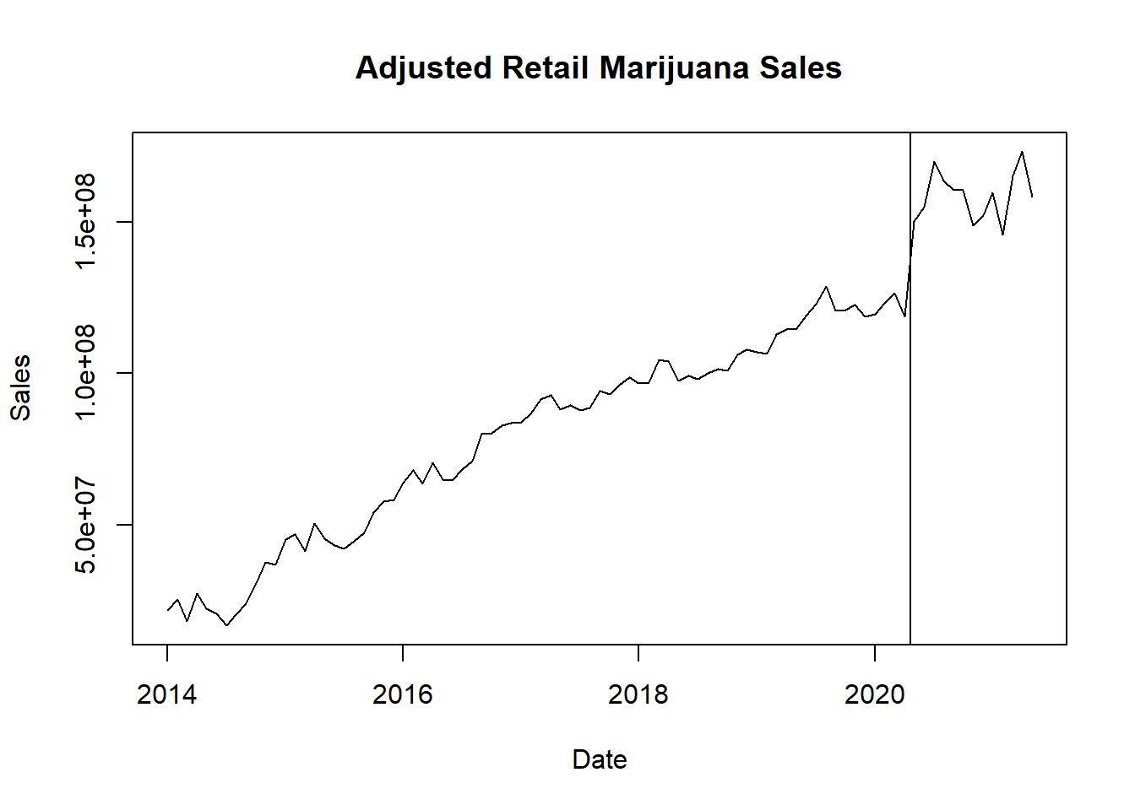

Removing Regular Fluctuation or Seasonality in Data
P-value Low: Strong Evidence that Sales Changed after breakpoint of March 2020

Slide 8
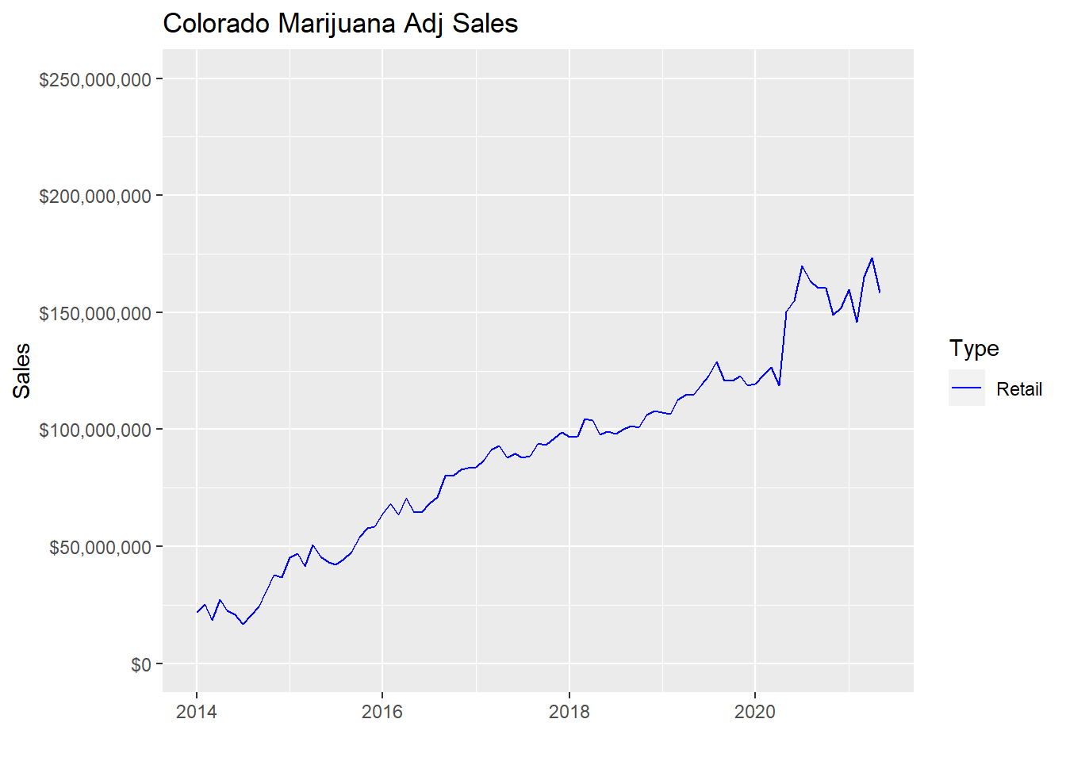
Sales with Lockdown Marker

Slide 9
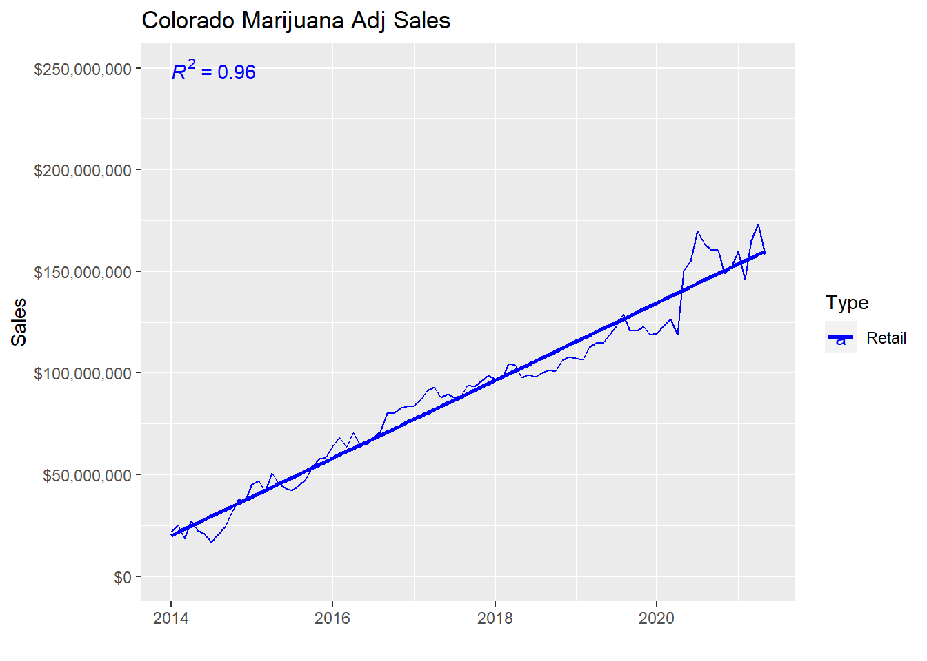
Linear Model over Retail Sales
Intercept: -820223093
Slope: 52281.5

Slide 10
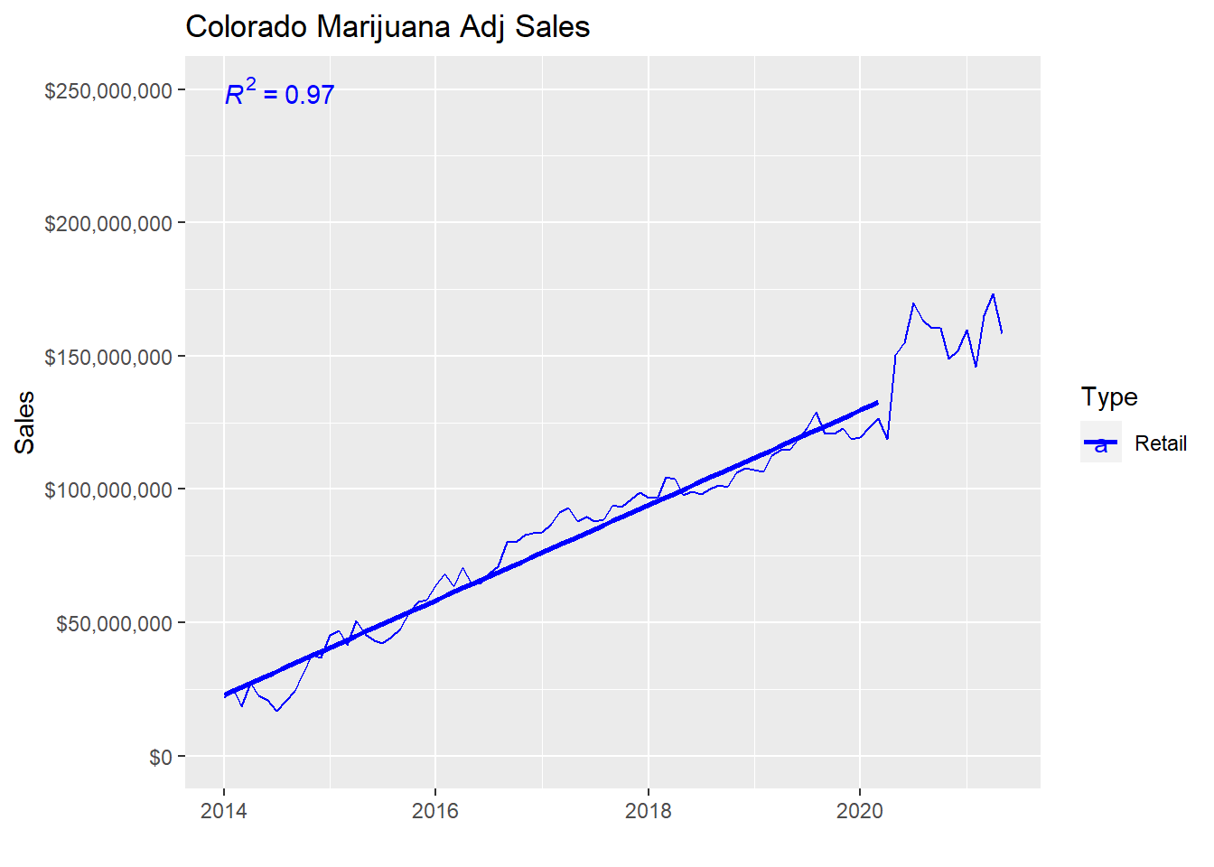
Linear Model over Retail Sales – Pre Lockdown
Intercept: -764228325
Slope: 448963.47

Slide 11
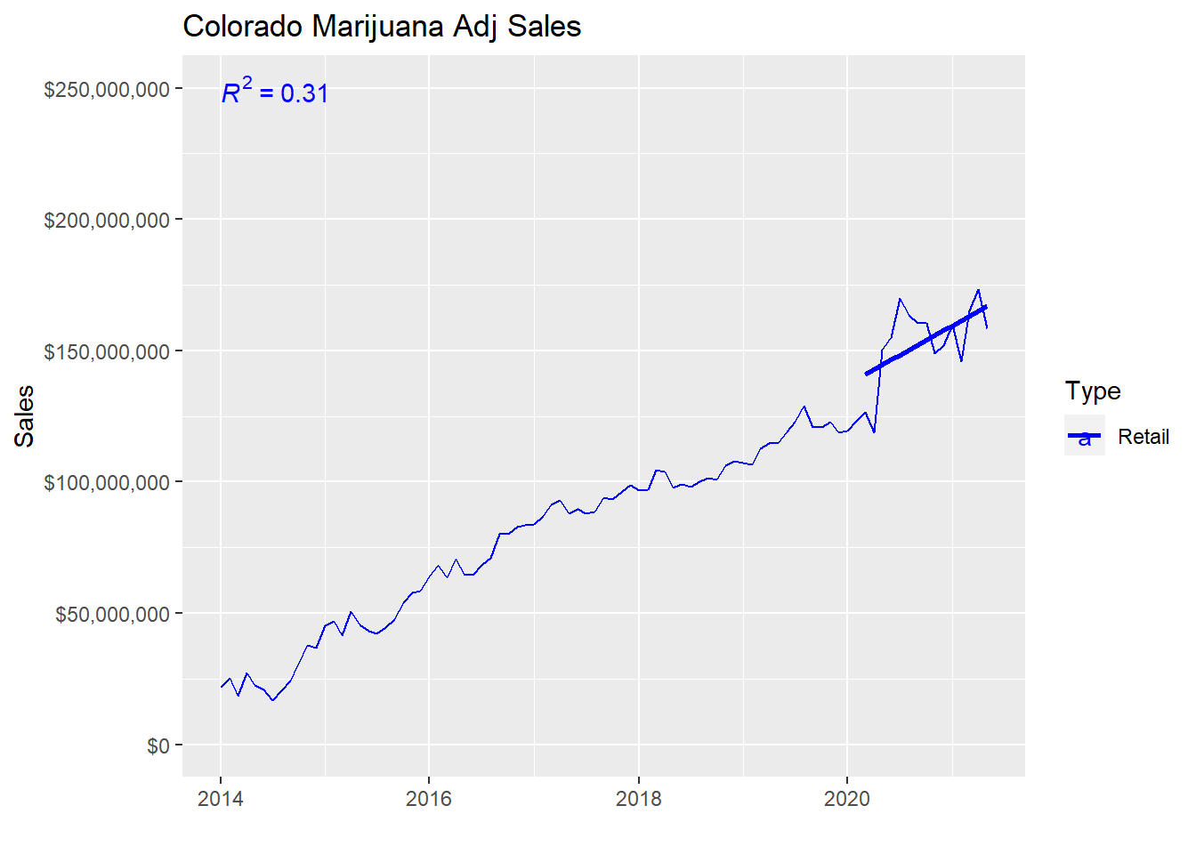
Linear Model over Retail Sales – Post Lockdown
Intercept: -977204478
Slope: 61020.1

Slide 12
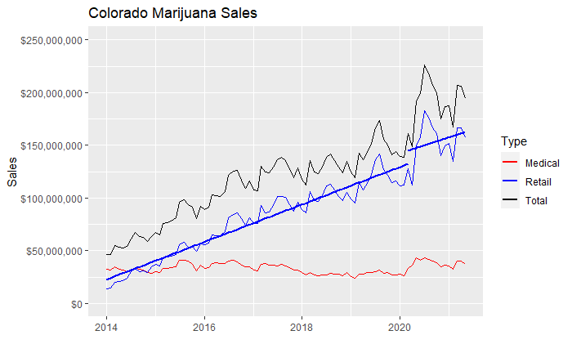
Combined Linear Models over Retail Sales

Slide 13
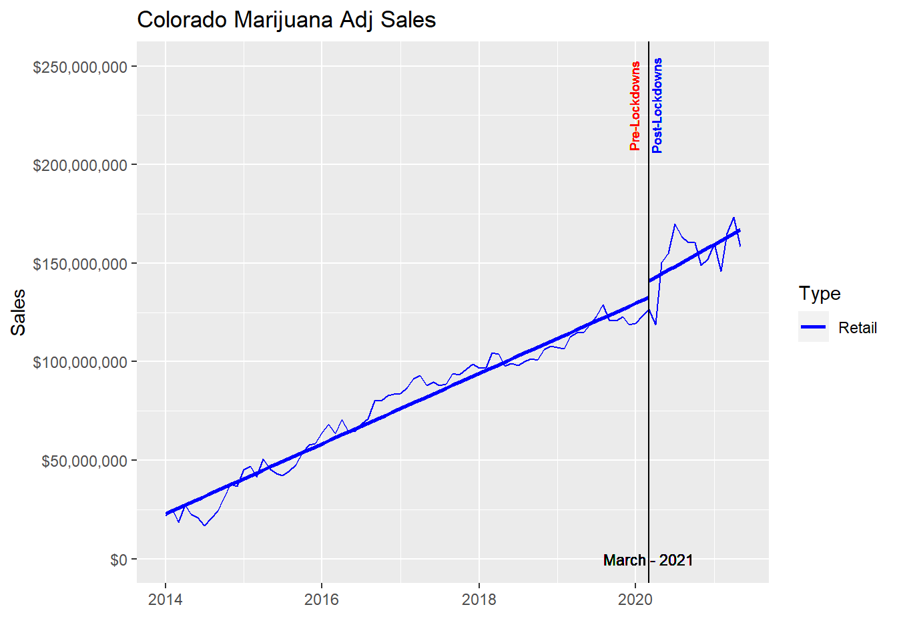
Stay-at-home Lockdown Marker

Slide 14
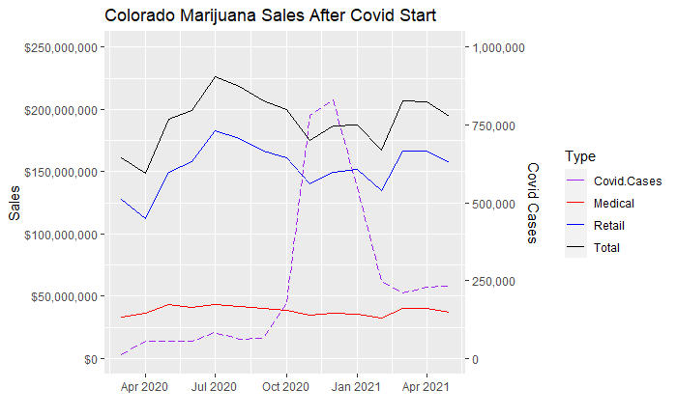
Retail Sales and Covid Cases

Slide 15
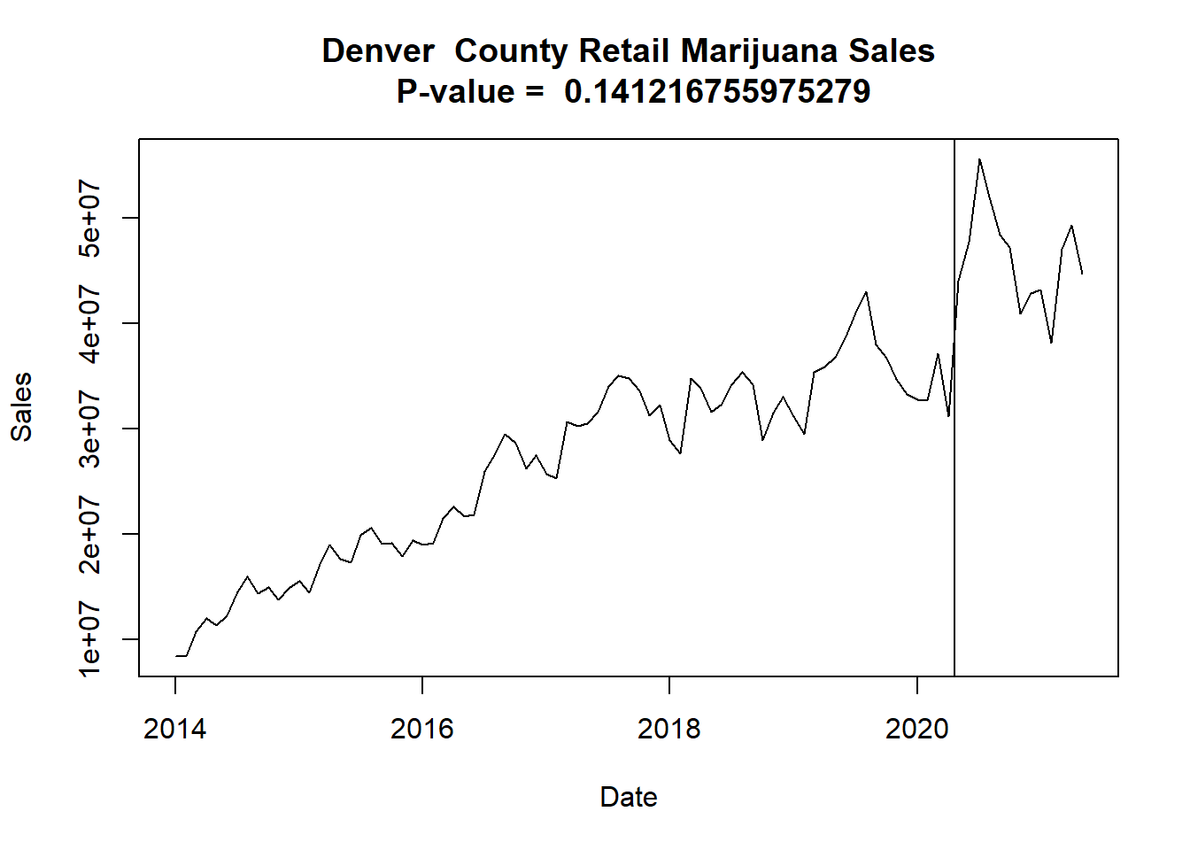
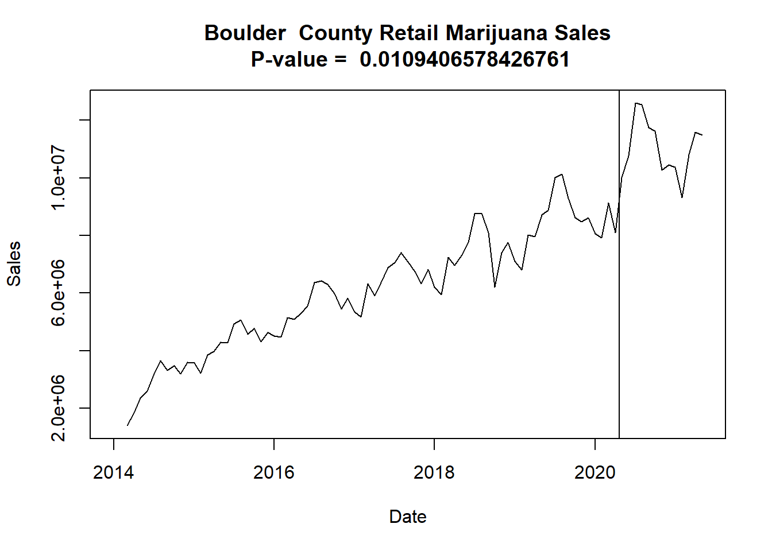
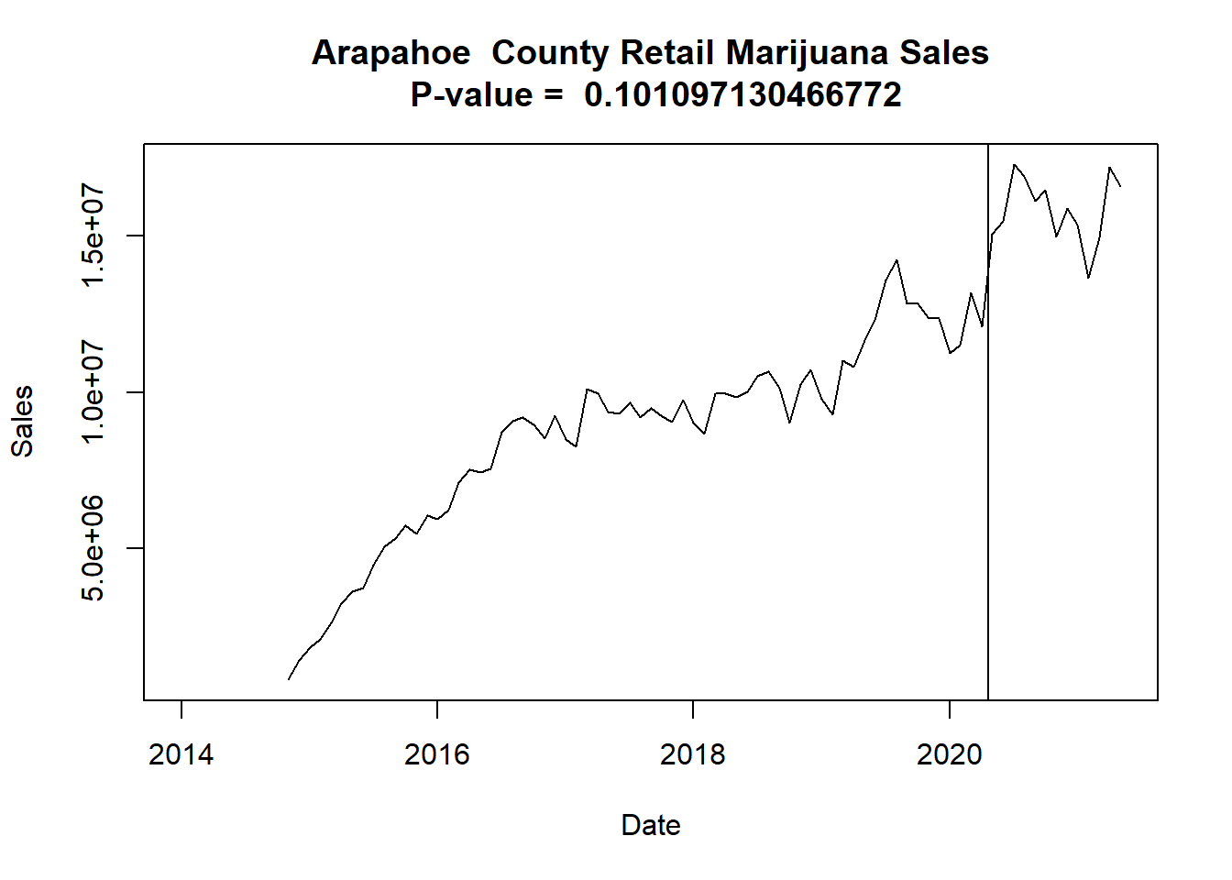
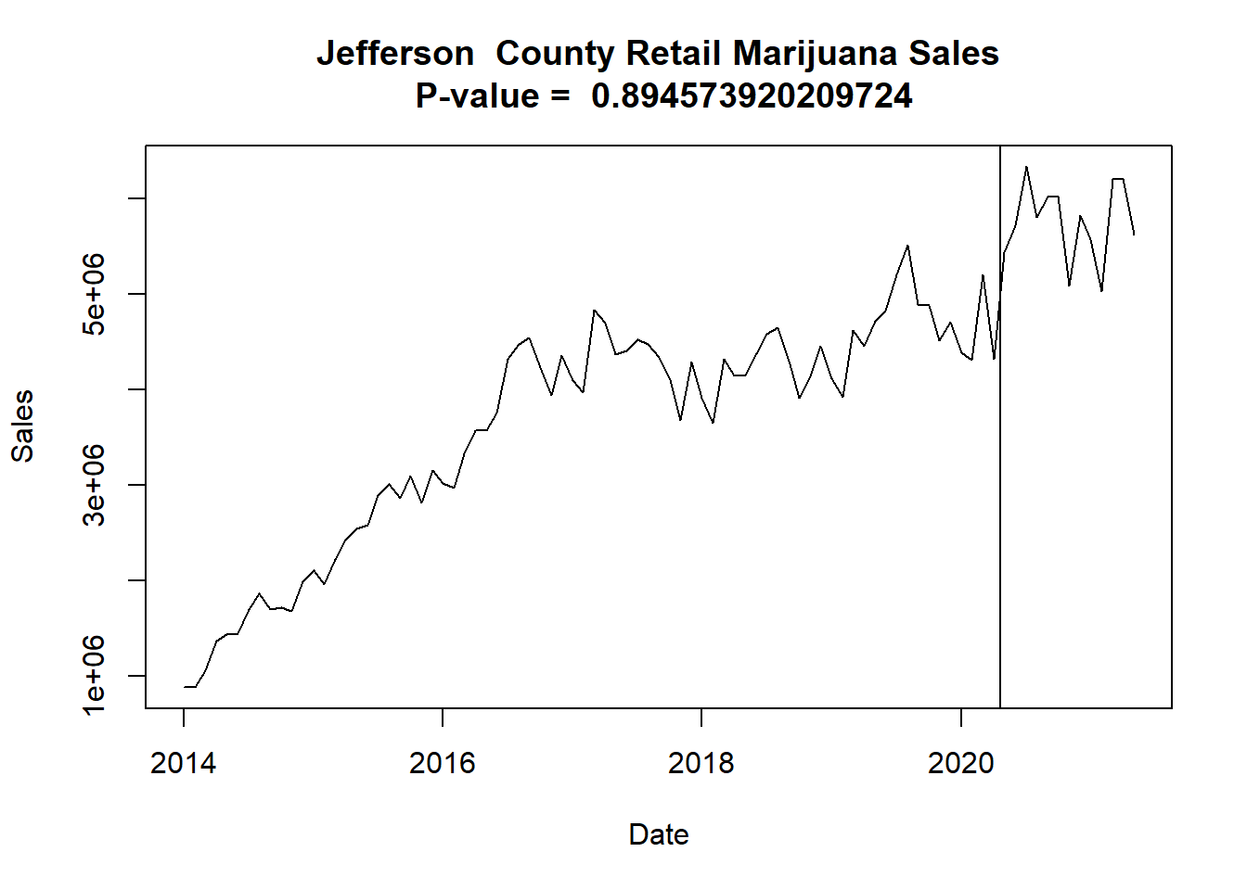
County Level Data
## County DataPoints PValue Reject_Null
## 1 Adams 77 4.810252e-11 TRUE
## 2 Arapahoe 79 1.010971e-01 FALSE
## 3 Archuleta 51 4.137149e-04 TRUE
## 4 Bent 5 NA NA
## 5 Boulder 87 1.094066e-02 TRUE
## 6 Chaffee 61 3.433096e-01 FALSE
## 7 Clear.Creek 89 7.132070e-02 FALSE
## 8 Conejos 42 2.240083e-02 TRUE
## 9 Costilla 64 2.220447e-05 TRUE
## 10 Crowley 0 NA NA
## 11 Denver 89 1.412168e-01 FALSE
## 12 Eagle 82 4.507621e-01 FALSE
## 13 El.Paso 0 NA NA
## 14 Garfield 85 2.785385e-01 FALSE
## 15 Gilpin 86 3.602572e-01 FALSE
## 16 Grand 69 7.255423e-01 FALSE
## 17 Gunnison 81 4.588904e-01 FALSE
## 18 Huerfano 26 1.008087e-01 FALSE
## 19 Jefferson 89 8.945739e-01 FALSE
## 20 Lake 45 8.549919e-02 FALSE
## 21 La.Plata 79 1.091498e-06 TRUE
## 22 Larimer 83 1.102853e-02 TRUE
## 23 Las.Animas 77 4.864853e-02 TRUE
## 24 Mesa 45 6.823595e-03 TRUE
## 25 Moffat 29 1.740382e-03 TRUE
## 26 Montezuma 76 1.074009e-01 FALSE
## 27 Montrose 0 NA NA
## 28 Morgan 52 4.277714e-04 TRUE
## 29 Otero 14 NA NA
## 30 Ouray 50 1.464512e-01 FALSE
## 31 Park 75 4.088663e-06 TRUE
## 32 Pitkin 86 1.783652e-01 FALSE
## 33 Pueblo 89 2.058353e-13 TRUE
## 34 Routt 76 1.851871e-02 TRUE
## 35 Saguache 45 2.355935e-03 TRUE
## 36 San.Juan 9 NA NA
## 37 San.Miguel 88 8.964043e-01 FALSE
## 38 Sedgwick 8 NA NA
## 39 Summit 89 1.240698e-01 FALSE
## 40 Weld 86 7.515368e-01 FALSE
14 Counties show evidence of increased Marijuana Sales after March 2020

Slide 16
Conclusions
Evidence of change in marijuana sales trend before and after Covid-19 lockdowns at the Colorado Level
Lockdowns due to Covid-19 show more possible correlation to a deviation in marijuana sales trends than the actual cases of Covid do
Not all Counties show evidence of an increase in Marijuana Sales, though the most populous do contributing to overall increase in CO
Further research to determine the extent of the increase

Slide 17

Questions

